Slide 1
Stormwater Management and MS4 Compliance
Presented by the South Londonderry Township Environmental Advisory Council

Slide 2
What is Stormwater?

Slide 3
Why do we manage stormwater?

Slide 4
How is stormwater managed?

Slide 5
Stormwater versus Wastewater

Slide 6
What is a MS4 Permit?
MS4 stands for Municipal Separate Storm Sewer System
An MS4 is a conveyance or system of conveyances that is:
Owned by a state, city, town, village, or other public entity that discharges to waters of the US;
Designed or used to collect or convey stormwater (e.g., storm drains, pipes, ditches);
Not a combined sewer, and;
Not part of a sewage treatment plant, or publicly owned treatment works.
This permit is a federal EPA National Pollution Discharge Elimination System (NPDES) permit administered through the Commonwealth of Pennsylvania (PAG-13).
In Pennsylvania there are two Large MS4s, no Medium MS4s, and 953 Small MS4s

Slide 7
What is a regulated small MS4?
South Londonderry Township is designated as a regulated small MS4.
Defined as the portion of a small MS4 located within a designated Urbanized Area (UA) or a small MS4 that is specifically designated by DEP.
UA is based upon the US Census Bureau data (2010)

Slide 8
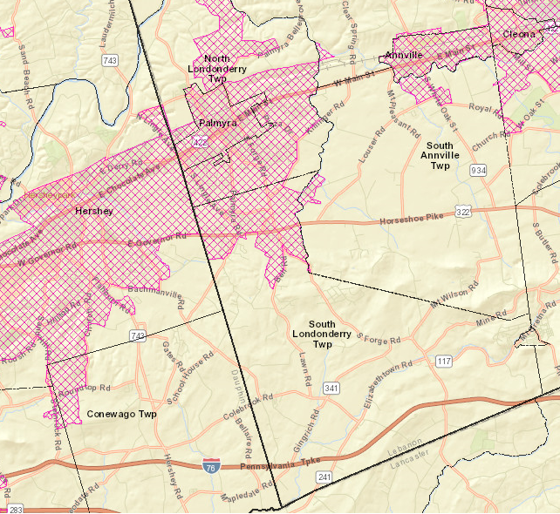

Slide 9
MS4 Permit Compliance
Permittee (South Londonderry Township) must develop and implement a stormwater management program of Best Management Practices (BMPs) to reduce the discharge of pollutants from the regulated MS4 to the Maximum Extent Practicable.
To accomplish this, MS4 Permits have 6 minimum control measures (MCMs)
Public Education and Outreach
Public Involvement and Participation
Illicit Discharge Detection and Elimination
Construction Site Stormwater Runoff Control
Post-Construction Stormwater Management
Pollution Prevention/Good Housekeeping

Slide 10
Changes to the MS4 Permit
MS4 Permit is on a 5 year cycle
The MS4 Permit is up for renewal this year
Applications for Notice of Intent (NOI) to discharge are due by September 16, 2017
New permit requires the submission of a pollution reduction plan
Includes local impaired waters, and
Chesapeake Bay
Pollution reduction plan needs to be submitted for public comment no later than August 3, 2017

Slide 11
What is a Pollution Reduction Plan?
A pollution reduction plan describes how the permittee will accomplish the required pollution reduction for an impaired water body
The plan must detail where improvements will be made
The plan must detail how the improvements will be funded
How does the permittee know what improvements they need to make?

Slide 12
What are SLT’s requirements?

Slide 13
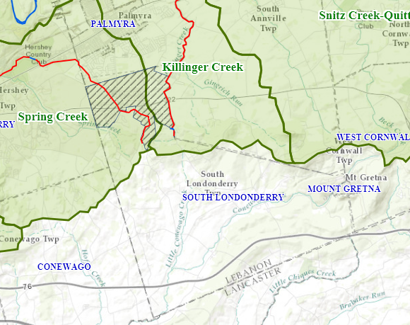

Slide 14
What’s a TMDL?
A TMDL stands for Total Maximum Daily Load. It’s the amount of pollution a water body can receive and still meet water quality standards.
Think of it as a “pollution diet”
TMDLs are expensive to comply with
TMDLs force a permittee into an individual permit instead of a general permit, which also increases costs
Currently South Londonderry Township does not have any TMDLs
Pollution reduction plans are a mechanism to keep permittees from having TMDLs imposed on their impaired waters

Slide 15
Wrapping things up
South Londonderry Township is a current MS4 permittee
Their existing permit is up for renewal this year
DEP has changed some of the permit requirements
One of those changes, the pollution reduction plans, will require significant investment by SLT to maintain permit compliance
Those investments, although costly, can help avoid additional future costs associated with more stringent regulatory requirements, such as TMDL compliance
The point of the permit and pollution reduction plans is to improve our local and regional water quality
What can you do?
Our stormwater gets directed to our local streams – IT DOES NOT GO THROUGH THE WASTEWATER TREATMENT PLANT
If you pour something into a storm sewer inlet, it’s like pouring it directly into a stream

Slide 16
Questions?

